Slide 1
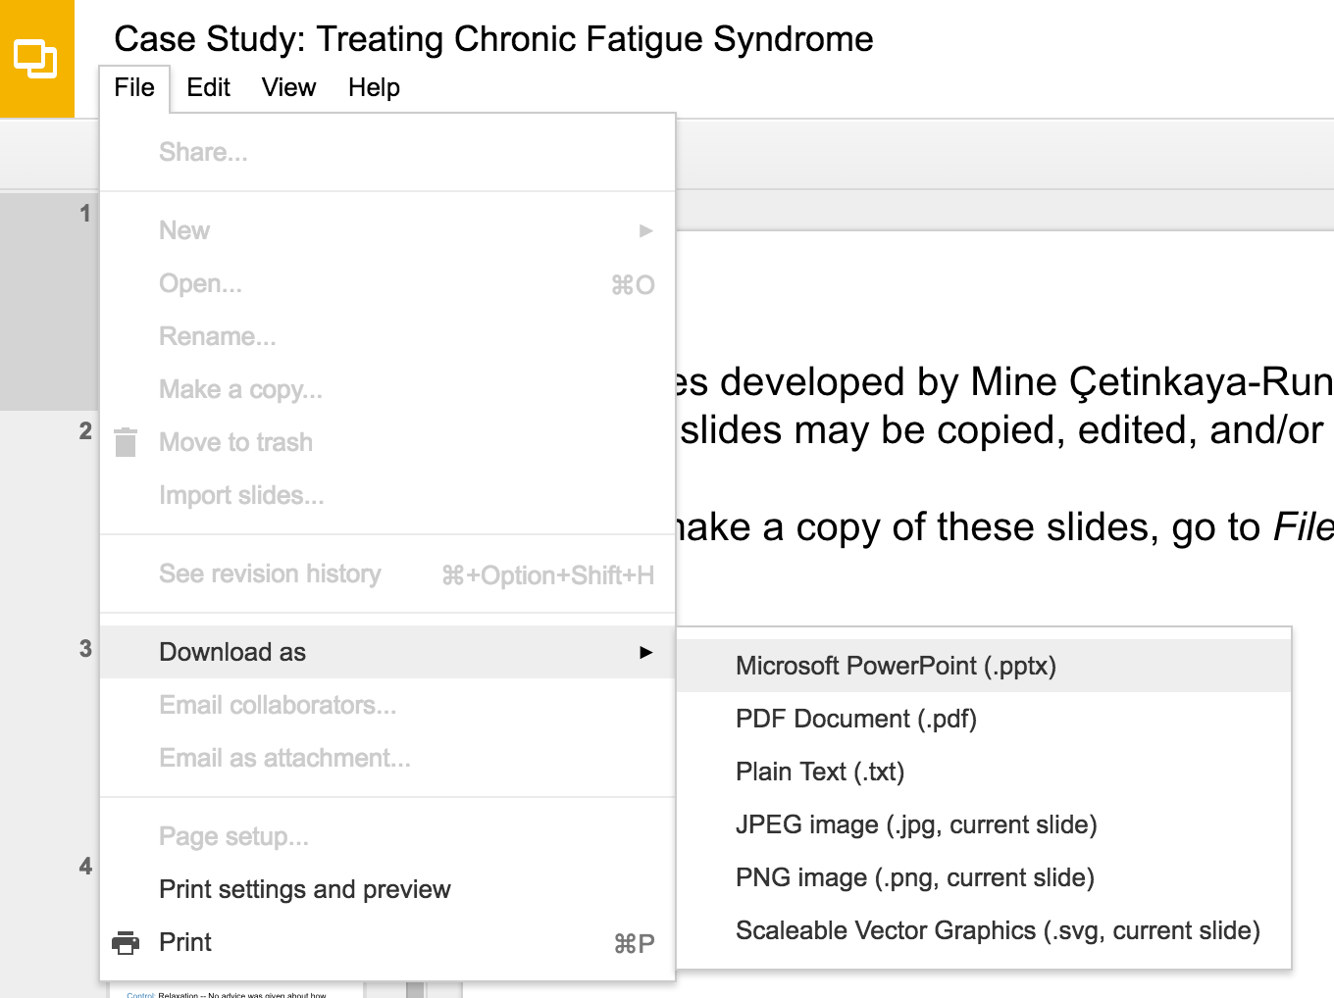
Slides developed by Mine Çetinkaya-Rundel of OpenIntro
Translated from LaTeX to Google Slides by Curry W. Hilton of OpenIntro.
The slides may be copied, edited, and/or shared via the CC BY-SA license
To make a copy of these slides, go to File > Download as > [option], as shown below. Or if you are logged into a Google account, you can choose Make a copy... to create your own version in Google Drive.

Slide 2
Introduction
to Probability

Slide 3
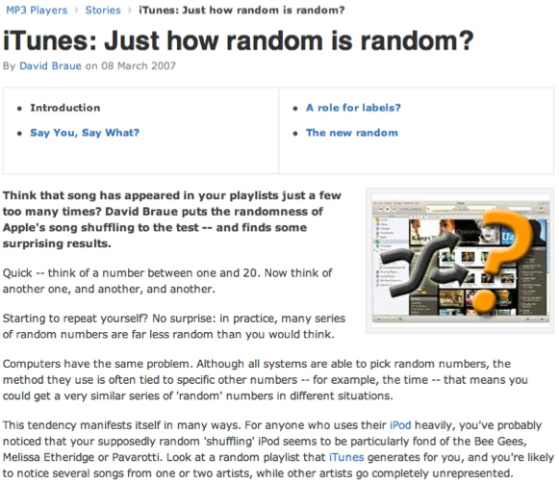
Random processes
A random process is a situation in which we know what outcomes could happen, but we don't know which particular outcome will happen.
Examples: coin tosses, die rolls, iTunes shuffle, whether the stock market goes up or down tomorrow, etc.
It can be helpful to model a process as random even if it is not truly random.
http://www.cnet.com.au/itunes-just-how-random-is-random-339274094.htm

Slide 4
Probability
There are several possible interpretations of probability but they (almost) completely agree on the mathematical rules probability must follow.
P(A) = Probability of event A
0 ≤ P(A) ≤ 1

Slide 5
Probability
There are several possible interpretations of probability but they (almost) completely agree on the mathematical rules probability must follow.
P(A) = Probability of event A
0 ≤ P(A) ≤ 1
Frequentist interpretation:
The probability of an outcome is the proportion of times the outcome would occur if we observed the random process an infinite number of times.

Slide 6
Probability
There are several possible interpretations of probability but they (almost) completely agree on the mathematical rules probability must follow.
P(A) = Probability of event A
0 ≤ P(A) ≤ 1
Frequentist interpretation:
The probability of an outcome is the proportion of times the outcome would occur if we observed the random process an infinite number of times.
Bayesian interpretation:
A Bayesian interprets probability as a subjective degree of belief: For the same event, two separate people could have different viewpoints and so assign different probabilities.
Largely popularized by revolutionary advance in computational technology and methods during the last twenty years.

Slide 7
Practice
Which of the following events would you be most surprised by?
(a) exactly 3 heads in 10 coin flips
(b) exactly 3 heads in 100 coin flips
(c) exactly 3 heads in 1000 coin flips

Slide 8
Practice
Which of the following events would you be most surprised by?
(a) exactly 3 heads in 10 coin flips
(b) exactly 3 heads in 100 coin flips
(c) exactly 3 heads in 1000 coin flips

Slide 9
Law of large numbers
Law of large numbers states that as more observations are collected, the proportion of occurrences with a particular outcome, p̂n, converges to the probability of that outcome, p.

Slide 10

Law of large numbers (cont.)
When tossing a fair coin, if heads comes up on each of the first 10 tosses, what do you think the chance is that another head will come up on the next toss? 0.5, less than 0.5, or more than 0.5?

Slide 11
Law of large numbers (cont.)
When tossing a fair coin, if heads comes up on each of the first 10 tosses, what do you think the chance is that another head will come up on the next toss? 0.5, less than 0.5, or more than 0.5?
The probability is still 0.5, or there is still a 50% chance that another head will come up on the next toss.
P(H on 11th toss) = P(T on 11th toss) = 0.5

Slide 12
Law of large numbers (cont.)
When tossing a fair coin, if heads comes up on each of the first 10 tosses, what do you think the chance is that another head will come up on the next toss? 0.5, less than 0.5, or more than 0.5?
The probability is still 0.5, or there is still a 50% chance that another head will come up on the next toss.
P(H on 11th toss) = P(T on 11th toss) = 0.5
The coin is not “due” for a tail.

Slide 13
Law of large numbers (cont.)
When tossing a fair coin, if heads comes up on each of the first 10 tosses, what do you think the chance is that another head will come up on the next toss? 0.5, less than 0.5, or more than 0.5?
The probability is still 0.5, or there is still a 50% chance that another head will come up on the next toss.
P(H on 11th toss) = P(T on 11th toss) = 0.5
The coin is not “due” for a tail.
The common misunderstanding of the LLN is that random processes are supposed to compensate for whatever happened in the past; this is just not true and is also called gambler’s fallacy (or law of averages).

Slide 14
Disjoint and non-disjoint outcomes
Disjoint (mutually exclusive) outcomes: Cannot happen at the same time.
The outcome of a single coin toss cannot be a head and a tail.
A student both cannot fail and pass a class.
A single card drawn from a deck cannot be an ace and a queen.

Slide 15
Disjoint and non-disjoint outcomes
Disjoint (mutually exclusive) outcomes: Cannot happen at the same time.
The outcome of a single coin toss cannot be a head and a tail.
A student both cannot fail and pass a class.
A single card drawn from a deck cannot be an ace and a queen.
Non-disjoint outcomes: Can happen at the same time.
A student can get an A in Stats and A in Econ in the same semester.

Slide 16
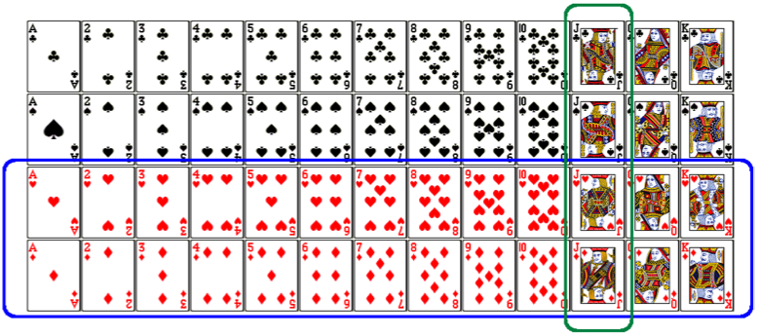
Union of non-disjoint events
What is the probability of drawing a jack or a red card from a well shuffled full deck?
Figure from http://www.milefoot.com/math/discrete/counting/cardfreq.htm

Slide 17
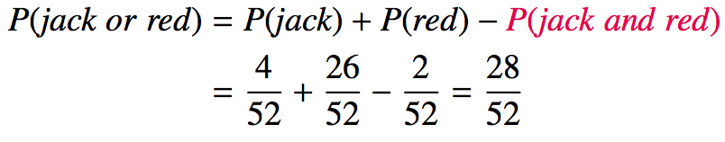
Union of non-disjoint events
What is the probability of drawing a jack or a red card from a well shuffled full deck?
Figure from http://www.milefoot.com/math/discrete/counting/cardfreq.htm

Slide 18
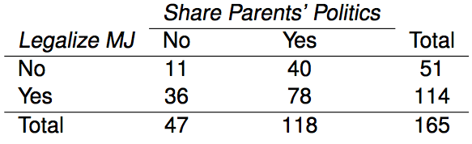
Practice
What is the probability that a randomly sampled student thinks marijuana should be legalized or they agree with their parents' political views?
(a) (40 + 36 - 78) / 165
(b) (114 + 118 - 78) / 165
(c) 78 / 165
(d) 78 / 188
(e) 11 / 47

Slide 19
Practice
What is the probability that a randomly sampled student thinks marijuana should be legalized or they agree with their parents' political views?
(a) (40 + 36 - 78) / 165
(b) (114 + 118 - 78) / 165
(c) 78 / 165
(d) 78 / 188
(e) 11 / 47

Slide 20
Recap
General addition rule
P(A or B) = P(A) + P(B) - P(A and B)
Note: For disjoint events P(A and B) = 0, so the above formula simplifies to P(A or B) = P(A) + P(B)

Slide 21
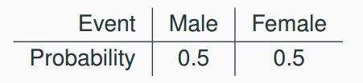
Probability distributions
A probability distribution lists all possible events and the probabilities with which they occur.
The probability distribution for the gender of one kid:

Slide 22
Probability distributions
A probability distribution lists all possible events and the probabilities with which they occur.
The probability distribution for the gender of one kid:
Rules for probability distributions:
1. The events listed must be disjoint
2. Each probability must be between 0 and 1
3. The probabilities must total 1

Slide 23
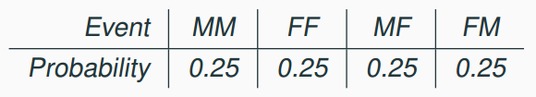
Probability distributions
A probability distribution lists all possible events and the probabilities with which they occur.
The probability distribution for the gender of one kid:
Rules for probability distributions:
1. The events listed must be disjoint
2. Each probability must be between 0 and 1
3. The probabilities must total 1
The probability distribution for the genders of two kids:

Slide 24
Practice
In a survey, 52% of respondents said they are Democrats. What is the probability that a randomly selected respondent from this sample is a Republican?
(a) 0.48
(b) more than 0.48
(c) less than 0.48
(d) cannot calculate using only the information given

Slide 25
Practice
In a survey, 52% of respondents said they are Democrats. What is the probability that a randomly selected respondent from this sample is a Republican?
(a) 0.48
(b) more than 0.48
(c) less than 0.48
(d) cannot calculate using only the information given
If the only two political parties are Republican and Democrat, then (a) is possible. However it is also possible that some people do not affiliate with a political party or affiliate with a party other than these two. Then (c) is also possible. However (b) is definitely not possible since it would result in the total probability for the sample space being above 1.

Slide 26
Sample space and complements
Sample space is the collection of all possible outcomes of a trial.
A couple has one kid, what is the sample space for the gender of this kid? S = {M, F}
A couple has two kids, what is the sample space for the gender of these kids?

Slide 27
Sample space and complements
Sample space is the collection of all possible outcomes of a trial.
A couple has one kid, what is the sample space for the gender of this kid? S = {M, F}
A couple has two kids, what is the sample space for the gender of these kids?
S = {MM, FF, FM, MF}

Slide 28
Sample space and complements
Sample space is the collection of all possible outcomes of a trial.
A couple has one kid, what is the sample space for the gender of this kid? S = {M, F}
A couple has two kids, what is the sample space for the gender of these kids?
S = {MM, FF, FM, MF}
Complementary events are two mutually exclusive events whose probabilities that add up to 1.
A couple has one kid. If we know that the kid is not a boy, what is gender of this kid? { M, F } Boy and girl are complementary outcomes.
A couple has two kids, if we know that they are not both girls, what are the possible gender combinations for these kids?

Slide 29
Sample space and complements
Sample space is the collection of all possible outcomes of a trial.
A couple has one kid, what is the sample space for the gender of this kid? S = {M, F}
A couple has two kids, what is the sample space for the gender of these kids?
S = {MM, FF, FM, MF}
Complementary events are two mutually exclusive events whose probabilities that add up to 1.
A couple has one kid. If we know that the kid is not a boy, what is gender of this kid? { M, F } Boy and girl are complementary outcomes.
A couple has two kids, if we know that they are not both girls, what are the possible gender combinations for these kids?
S = { MM, FF, FM, MF }

Slide 30
Independence
Two processes are independent if knowing the outcome of one provides no useful information about the outcome of the other.

Slide 31
Independence
Two processes are independent if knowing the outcome of one provides no useful information about the outcome of the other.
Knowing that the coin landed on a head on the first toss does not provide any useful information for determining what the coin will land on in the second toss. >> Outcomes of two tosses of a coin are independent.

Slide 32
Independence
Two processes are independent if knowing the outcome of one provides no useful information about the outcome of the other.
Knowing that the coin landed on a head on the first toss does not provide any useful information for determining what the coin will land on in the second toss. >> Outcomes of two tosses of a coin are independent.
Knowing that the first card drawn from a deck is an ace does provide useful information for determining the probability of drawing an ace in the second draw. >> Outcomes of two draws from a deck of cards (without replacement) are dependent.

Slide 33
Practice
Between January 9-12, 2013, SurveyUSA interviewed a random sample of 500 NC residents asking them whether they think widespread gun ownership protects law abiding citizens from crime, or makes society more dangerous. 58% of all respondents said it protects citizens. 67% of White respondents, 28% of Black respondents, and 64% of Hispanic respondents shared this view. Which of the below is true?
Opinion on gun ownership and race ethnicity are most likely
(a) complementary
(b) mutually exclusive
(c) independent
(d) dependent
(e) disjoint
http://www.surveyusa.com/client/PollReport.aspx?g=a5f460ef-bba9-484b-8579-1101ea26421b

Slide 34
Practice
Between January 9-12, 2013, SurveyUSA interviewed a random sample of 500 NC residents asking them whether they think widespread gun ownership protects law abiding citizens from crime, or makes society more dangerous. 58% of all respondents said it protects citizens. 67% of White respondents, 28% of Black respondents, and 64% of Hispanic respondents shared this view. Which of the below is true?
Opinion on gun ownership and race ethnicity are most likely
(a) complementary
(b) mutually exclusive
(c) independent
(d) dependent
(e) disjoint
http://www.surveyusa.com/client/PollReport.aspx?g=a5f460ef-bba9-484b-8579-1101ea26421b

Slide 35
Checking for independence
If P(A occurs, given that B is true) = P(A | B) = P(A), then A and B are independent.

Slide 36
Checking for independence
If P(A occurs, given that B is true) = P(A | B) = P(A), then A and B are independent.
P(protects citizens) = 0.58

Slide 37
Checking for independence
If P(A occurs, given that B is true) = P(A | B) = P(A), then A and B are independent.
P(protects citizens) = 0.58
P(randomly selected NC resident says gun ownership protects citizens, given that the resident is white)
= P(protects citizens | White) = 0.67
P(protects citizens | Black) = 0.28
P(protects citizens | Hispanic) = 0.64
P(protects citizens) varies by race/ethnicity, therefore opinion on gun ownership and race ethnicity are most likely dependent.

Slide 38
Determining dependence
based on sample data
If conditional probabilities calculated based on sample data suggest dependence between two variables, the next step is to conduct a hypothesis test to determine if the observed difference between the probabilities is likely or unlikely to have happened by chance.
If the observed difference between the conditional probabilities is large, then there is stronger evidence that the difference is real.
If a sample is large, then even a small difference can provide strong evidence of a real difference.

Slide 39
Determining dependence
based on sample data
If conditional probabilities calculated based on sample data suggest dependence between two variables, the next step is to conduct a hypothesis test to determine if the observed difference between the probabilities is likely or unlikely to have happened by chance.
If the observed difference between the conditional probabilities is large, then there is stronger evidence that the difference is real.
If a sample is large, then even a small difference can provide strong evidence of a real difference.
We saw that P(protects citizens | White) = 0.67 and P(protects citizens | Hispanic) = 0.64. Under which condition would you be more convinced of a real difference between the proportions of Whites and Hispanics who think gun widespread gun ownership protects citizens? n = 500 or n = 50,000

Slide 40
Determining dependence
based on sample data
If conditional probabilities calculated based on sample data suggest dependence between two variables, the next step is to conduct a hypothesis test to determine if the observed difference between the probabilities is likely or unlikely to have happened by chance.
If the observed difference between the conditional probabilities is large, then there is stronger evidence that the difference is real.
If a sample is large, then even a small difference can provide strong evidence of a real difference.

Slide 41
Determining dependence
based on sample data
If conditional probabilities calculated based on sample data suggest dependence between two variables, the next step is to conduct a hypothesis test to determine if the observed difference between the probabilities is likely or unlikely to have happened by chance.
If the observed difference between the conditional probabilities is large, then there is stronger evidence that the difference is real.
If a sample is large, then even a small difference can provide strong evidence of a real difference.
We saw that P(protects citizens | White) = 0.67 and P(protects citizens | Hispanic) = 0.64. Under which condition would you be more convinced of a real difference between the proportions of Whites and Hispanics who think gun widespread gun ownership protects citizens? n = 500 or n = 50,000

Slide 42
Product rule for independent events
P(A and B) = P(A) x P(B)
Or more generally, P(A₁, and, … and A_{k}) = P(A₁) x … x P(A_{k})

Slide 43
Product rule for independent events
P(A and B) = P(A) x P(B)
Or more generally, P(A₁, and, … and A_{k}) = P(A₁) x … x P(A_{k})
You toss a coin twice, what is the probability of getting two tails in a row?

Slide 44
Product rule for independent events
P(A and B) = P(A) x P(B)
Or more generally, P(A₁, and, … and A_{k}) = P(A₁) x … x P(A_{k})
You toss a coin twice, what is the probability of getting two tails in a row?
P(T on the first toss) x P(T on the second toss) = ½ x ½ =¼

Slide 45
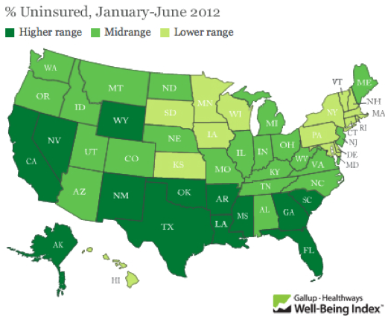
Practice
A recent Gallup poll suggests that 25.5% of Texans do not have health insurance as of June 2012. Assuming that the uninsured rate stayed constant, what is the probability that two randomly selected Texans are both uninsured?
(a) 25.5²
(b) 0.255²
(c) 0.255 x 2
(d) (1 - 0.255)²
http://www.gallup.com/poll/156851/uninsured-rate-stable-across-states-far-2012.aspx

Slide 46
Practice
A recent Gallup poll suggests that 25.5% of Texans do not have health insurance as of June 2012. Assuming that the uninsured rate stayed constant, what is the probability that two randomly selected Texans are both uninsured?
(a) 25.5²
(b) 0.255²
(c) 0.255 x 2
(d) (1 - 0.255)²
http://www.gallup.com/poll/156851/uninsured-rate-stable-across-states-far-2012.aspx

Slide 47
Disjoint vs. complementary
Do the sum of probabilities of two disjoint events always add up to 1?

Slide 48
Disjoint vs. complementary
Do the sum of probabilities of two disjoint events always add up to 1?
Not necessarily, there may be more than 2 events in the sample space, e.g. party affiliation.

Slide 49
Disjoint vs. complementary
Do the sum of probabilities of two disjoint events always add up to 1?
Not necessarily, there may be more than 2 events in the sample space, e.g. party affiliation.
Do the sum of probabilities of two complementary events always add up to 1?

Slide 50
Disjoint vs. complementary
Do the sum of probabilities of two disjoint events always add up to 1?
Not necessarily, there may be more than 2 events in the sample space, e.g. party affiliation.
Do the sum of probabilities of two complementary events always add up to 1?
Yes, that’s the definition of complementary, e.g. heads and tails

Slide 51
Putting everything together...
If we were to randomly select 5 Texans, what is the probability that at least one is uninsured?}
If we were to randomly select 5 Texans, the sample space for the number of Texans who are uninsured would be: S = {0, 1, 2, 3, 4, 5}
We are interested in instances where at least one person is uninsured: S = {0, 1, 2, 3, 4, 5}
So we can divide up the sample space into two categories: S = {0, at least one}

Slide 52
Putting everything together...
Since the probability of the sample space must add up to 1:
P(at least 1 uninsured)
= 1 - P(none insured)

Slide 53
Putting everything together...
Since the probability of the sample space must add up to 1:
P(at least 1 uninsured)
= 1 - P(none insured)
= 1 - (1 - 0.255)⁵

Slide 54
Putting everything together...
Since the probability of the sample space must add up to 1:
P(at least 1 uninsured)
= 1 - P(none insured)
= 1 - (1 - 0.255)⁵
= 1 - 0.745⁵

Slide 55
Putting everything together...
Since the probability of the sample space must add up to 1:
P(at least 1 uninsured)
= 1 - P(none insured)
= 1 - (1 - 0.255)⁵
= 1 - 0.745⁵
= 1 - 0.23

Slide 56
Putting everything together...
Since the probability of the sample space must add up to 1:
P(at least 1 uninsured)
= 1 - P(none insured)
= 1 - (1 - 0.255)⁵
= 1 - 0.745⁵
= 1 - 0.23
= 0.77

Slide 57
Putting everything together...
Since the probability of the sample space must add up to 1:
P(at least 1 uninsured)
= 1 - P(none insured)
= 1 - (1 - 0.255)⁵
= 1 - 0.745⁵
= 1 - 0.23
= 0.77
At least 1:
P(at least one) = 1 - P(none)

Slide 58
Practice
Roughly 20% of undergraduates at a university are vegetarian or vegan. What is the probability that, among a random sample of 3 undergraduates, at least one is vegetarian or vegan?
(a) 1 - 0.2 x 3
(b) 1 - 0.2³
(c) 0.8³
(d) 1 - 0.8 x 3
(e) 1 - 0.8³

Slide 59
Practice
Roughly 20% of undergraduates at a university are vegetarian or vegan. What is the probability that, among a random sample of 3 undergraduates, at least one is vegetarian or vegan?
(a) 1 - 0.2 x 3
(b) 1 - 0.2³
(c) 0.8³
(d) 1 - 0.8 x 3
(e) 1 - 0.8³
P(at least 1 from veg)
= 1 - P(none veg)
= 1 - 0.8³
= 1 - 0.512 = 0.488

Slide 60
Find more resources at openintro.org/stat
More Slides
Videos
Statistical Software Labs
Discussion Forums (free support for students and teachers)
Learning Objectives
Teachers only content
Exercise solutions
Sample exams
Ability to request a free desk copy for a course
Statistics Teachers email group
Questions? Contact us.

